Slide 1
Prestudy NG RDM\EFACTS\TEST MANAGER
Author: Martin Andersson

Slide 2
Background
Within FVV there is a difference between groups how they work with test of complete vehicle . Work performed within this area is to a large extent manual work with limited system support. There is a difference between groups, for instance PVT has today system support for preparing testcases , retrieve logfiles and analyze of tests. System support could be improved, functionality is lacking, performance and reliability of the systems are not satisfying.
AET\RT does not have any system support when it comes to create and plan testing(they work with physical ledgers), they use trigger functionality in the car to talk about an error when it appears during test and sometimes they also use the CAN logfiles created when triggering a recording for analyse purposes.
Safety:
Main system tools
eFACTS:
Is a set of applications that are used in Complete Vehicle testing. User organisations that use the system are PVT, RT, AET, Field Testing, Safety, VCE testing, Bus testing . The tool is used for log files connected to PROTUS reports, test cases and test execution management.
The tool was designed and created from a blank paper without requirements
Work started after FDCG had passed in P2540 = There was a lot of pressure to deliver a solution fast
Original intention: to be used at one site with a small number of users working with few vehicles from one brand
eFACTS has not been developed according to Volvo Group Architectural Principals

Slide 3
AS-IS situation

Slide 4
Current tools
PVT Test Manager
EFACTS
RDM

Slide 5
RDM Architectual Review
Non-standard components and technology used according to VIAP (Nginx Webserver 1.6, Pivotal RabbitMQ Server 3.4,Redis Server, Coffe Script, Ruby)
Proposed Action: Rewrite the application using any of the Volvo reference architectures for Java or .NET with an evolutionary approach instead of big-bang.
Non-compliant integration methods and technology
Proposed Action: Rewrite the application using any of the Volvo reference architectures for Java or .NET with compliant integration methods and technologies and an evolutionary approach instead of big-bang.
Non-compliant solution development process
The process used does not comply with any of these principles as defined at Volvo:
Agile / Lean-principles
ADF - Application Development Framework
Scrum /Kanban
Proposed Action: Provide education about ways of working according to the appointed Solution Development Processes at Volvo.

Slide 6
eFACTS(incl. PVT Manager) - Architectual Review

Slide 7
Architectual Review EFACTS
According to the EA review basically a full rewrite of EFACTS is required.
It does not follow Volvo Group Architectual principals.
Internal architecture is not domain oriented
It’s not loosly coupled to other systems
It does not integrate with other systems in a correct way.

Slide 8
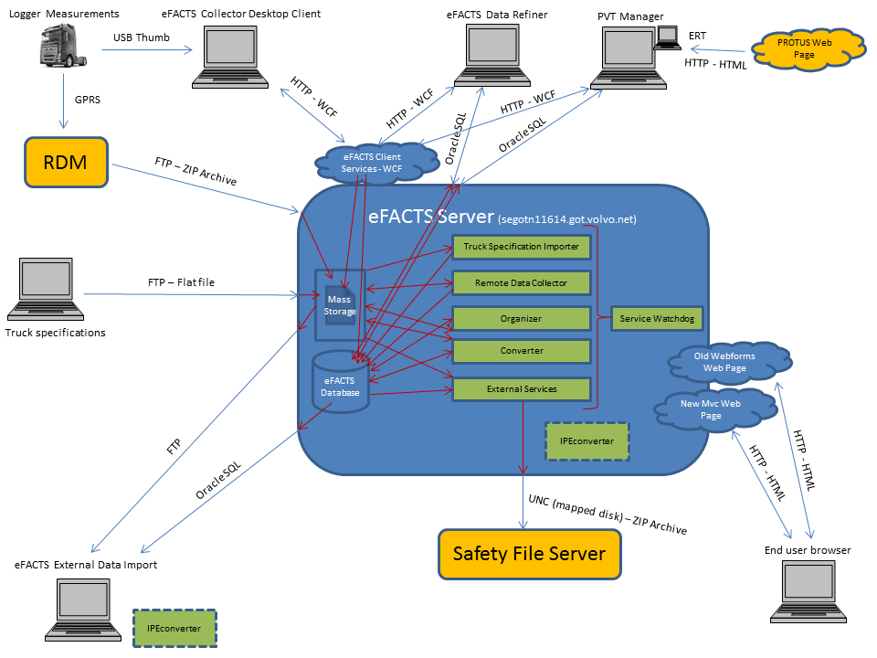

Slide 9
PVT - test
Preconditions:
Often 2 people in the vehicle(Often two drivers)
System usage: PVT Manager, EFACTS(EFACTS refiner), RDM

Slide 10
Terminology\Definitions
Test code\sekvens
Test routine(Not used today)
Test procedure(Not used today)

Slide 11
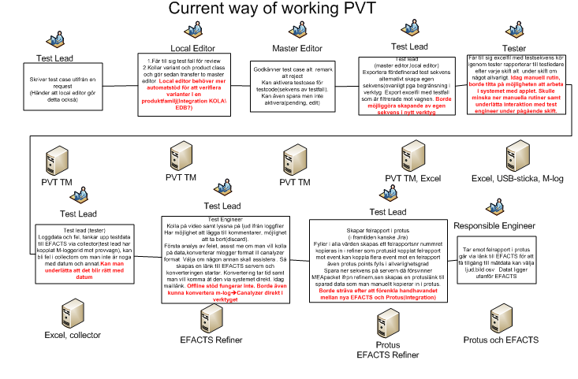

Slide 12
AET(Endurance Test) -Uthållighetstest
Preconditions:
Often only the driver in the vehicle
Test performed at test track
Test preparation: Basically manual process
Test execution:Basically manual process
Test analyze: Basically manual process, reports in Protus

Slide 13
Terminology\definitions
Test method(provmetod)
Våra metoder är en nedbrytning av krav som ställts från "Lundby" med avseende på vibrationer och aktiviteter som på något sätt kvantifierats. Våra metoder är anpassade för Hällered och andra banor är liknande men utfallet skiftar. Metoderna innehåller aktiviteter både beträffande körning på de olika banorna och verkstadsaktiviteter.
Test cycle
En beskrivning av vad som skall genomföras beträffande mängd körning samt aktiviteter och i vilken ordning detta skall utföras. Detta möjliggör att vi når samma mängd körning och aktivitet för olika provobjekt och vi håller reda på var vi är eller hur lång vi kommit i provförfarandet.
En slags exekvering av provmetod men inte allt i provmetoden det görs också en del inspektioner, administration/planering som ligger utanför testcykeln.

Slide 14
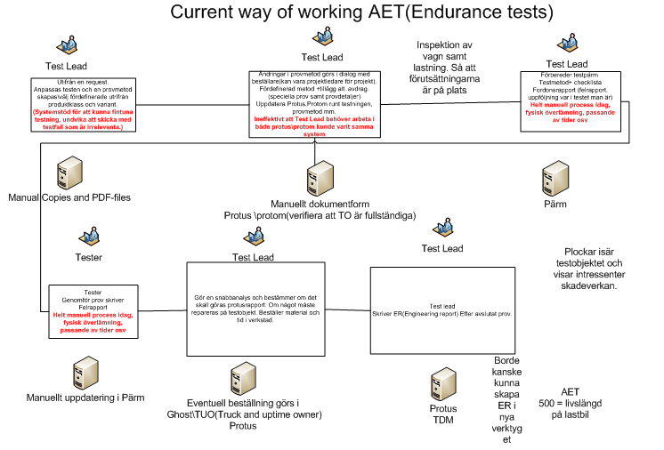

Slide 15
RT(Relaibility Tests) -Pålitlighetstest
Often only the driver in the vehicle
Test preparation: Basically manual process
Test execution:Basically manual process
Test analyze: Use EFACTS and sometimes RDM, data collector

Slide 16
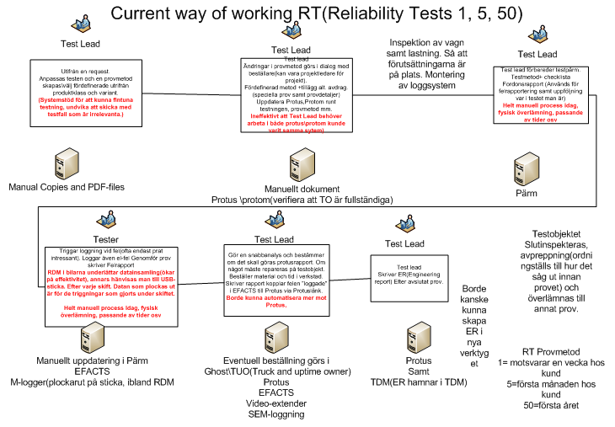

Slide 17
SAFETY -In scope and preconditions
Oftast 2 personer(förare samt test engineer(genomför testerna).
Test preparation: Basically manual process(Excel)
Test execution:Basically manual process(Excel)
Test analyze: canalyser

Slide 18
Terminology\definitions
Provmetod
FRS(Function Req specification)bryts ner till valida test(testmetod). El tar fram FRS till komplettvagn.
Delar av provmetod(utvalda test case ur provmetod)

Slide 19
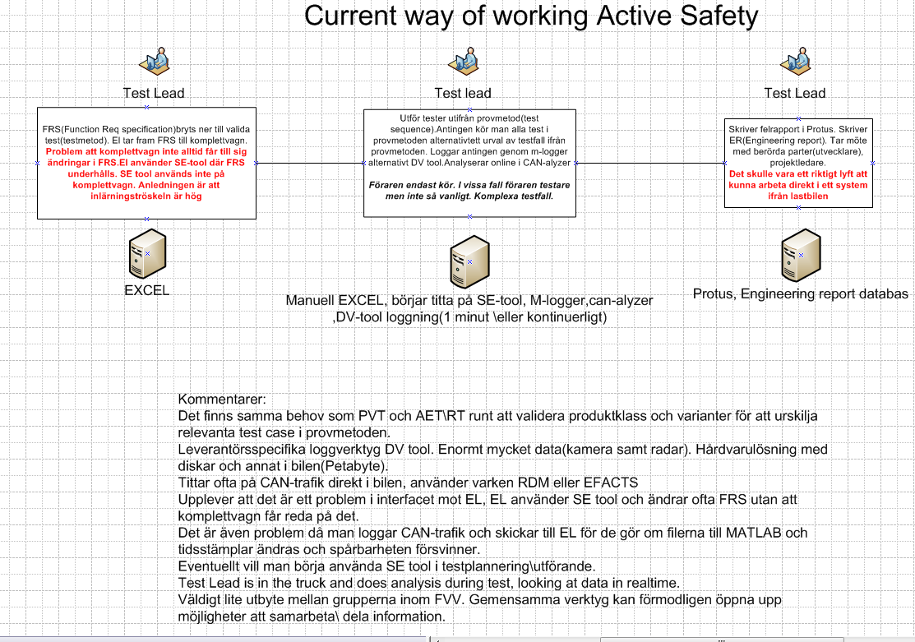

Slide 20
To-BE

Slide 21
Requirements work
Pre-study
Next Generation RDM\EFACTS\Test Manager

Slide 22
Holistic view
EPICS
(Logical way to group test cases) functional area or process step
One to many prototype mockups to verify towards business and to simplify development work
Test case 1
Test case 2
Test case X....
Test case is used instead of ”user stories”. It is decided that test cases should be the way to document requirements. This will also make it easier to implement TDD(Test Driven Development)

Slide 23
Business Requirements Breakdown
Prestudy should define the Business Requirement Breakdown to a certain level
Basically it is a way to breakdown high-level business goals into requirements and how to meet those with appointed IT solutions
Business Requirement Breakdown is required as an artifact to pass Enterprise Architectual review at gate XX.

Slide 24
Architectual Critical Requirements
Prestudy should define what architectual critical requirements there is
This will be necessary to be able to evaluate possible solutions and to be able to design solutions that meet business demands.

Slide 25
Prepare for Integration Request work -Business Part
During this job we should identify what need there is to integrate towards other systems
We should at least identify what type of data that is required and what sources there are to offer needed information(i.e. Existing services).
We should also identify what systems that will require data from systems in scope to meet business needs.

Slide 26
EPICS – Functional areas
User and group administration
Add\remove users
Add\remove groups
Add\ remove roles
Manage test components
Test case(CRUD)
Test sequence(CRUD)
Test routine(CRUD)
Test procedure(CRUD)
Test routes\map(CRUD)
Create test specification
Retrieve information from Ghost
WBS(sätter tid på)
Vagnsid
Chassiid
Etc.
Execute test:
Öppna test specifikation
Analyze follow up:
Report test:

Slide 27
Product Backlog - Test cases

Slide 28
Result
Conceptual solutions
Replace RDM\EFACTS\TEST MANAGER with development following architectual principals and Volvo Group target architecture
Solution including COTS solution
Delivery approach:
Order of delivery
One or more projects

Slide 29
COTS VS Inhouse Development
Is there any COTS products to investigate
If Volvo ITS development
What platform to choose
NVS - .NET for Volvo Solutions reference architecture
JVS – Java for Volvo Solutions reference architecture

Slide 30
Inhouse development
Follow 10 Architectual principles
DDD(Domain Driven Design)
TDD(Test Driven Design)
Platforms either:
NVS - .NET for Volvo Solutions reference architecture
JVS – Java for Volvo Solutions reference architecture

Slide 31
Inhouse development
Development method: Scrum\Kanban
Dedicated resources
At least 3-4 developer in the same location

Slide 32
Areas for improvement

Slide 34
Migration need

